Slide 1
Mechanical Engineering
Lucia Garay

Slide 2
Nature of Work
Mechanical Engineers Duties include the following:
Analyzing problems
Researching ways to help solve the problem
Designing or redesigning mechanical and thermal devices using analysis and computer-aided design
Developing and testing prototypes of designs they created
Analyzing test results and possibly improving the design
Overseeing the manufacturing process for the device

Slide 3
Required Skills
Creativity
Problem-Solving skill
Mathematics
Science
Video 1
Day in the Life: Mechanical Engineer
Video 2
Mechanical Engineer - Profiles of Scientists and Engineers

Slide 4
Job Outlook
2012 Median Pay was about $80,580 per year & $38.74 per hour
Lowest 10% earned less than $52,030
Top 10% earned more than $121,530.
Expected growth rate 5%
The top five engineer employing industries are listed in the chart below.
Computer and electronic product manufacturing | $84,860
Architectural, engineering, and related services | $84,030
Transportation equipment manufacturing | $83,540
Machinery manufacturing | $72,270
Fabricated metal product manufacturing | $69,890

Slide 5
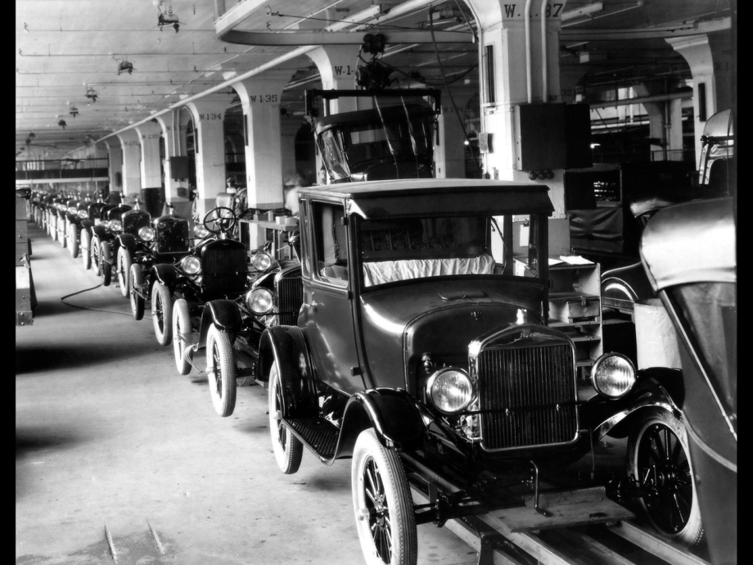
Ford Motor Company
Founded on June 16,1 1903
Founder Henry Ford
Headquarters Dearborn, Michigan
Designed and created the Model T automobile
Creation of the Model T lead to the development of the assembly line production concept

Slide 6
J.C. Bamford Excavators Limited
Also know as JCB
Founded 1945
Founder Joseph Cyril Bamford
Headquarters at Rocester, Staffordshire, United Kingdom
Designs and manufacturing equipment for construction, demolition and agriculture

Slide 7
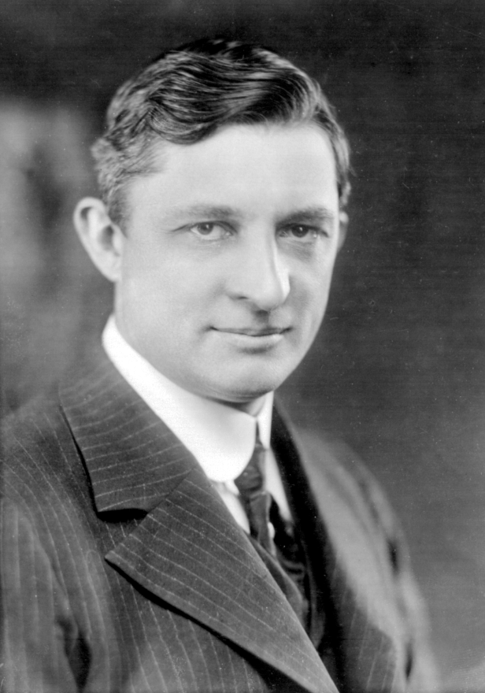
Willis Carrier
1876-1950
American inventor
Invented the first modern air conditioning

Slide 8
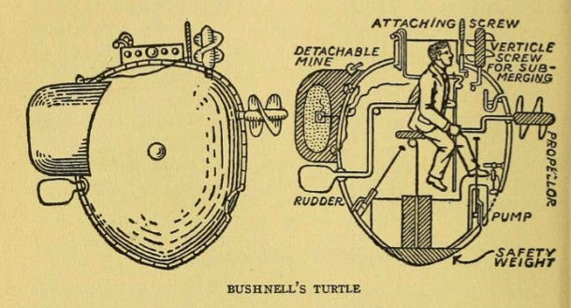
David Bushnell
1740–1824
Credited for creating the first submarine
His creation launched in 1776 and became known as the Turtle
At age 31, he attended Yale

Slide 9
Bibliography
http://www.bls.gov/ooh/architecture-and-engineering/mechanical-engineers.htm
http://www.bls.gov/ooh/architecture-and-engineering/mechanical-engineers.htm#tab-6\
http://education-portal.com/mechanical_engineer.html
www.carrier.com/carrier/en/us/about/willis-carrier/
http://connecticuthistory.org/david-bushnell-and-his-revolutionary-submarine/
http://en.wikipedia.org/wiki/Ford_Motor_Company
http://en.wikipedia.org/wiki/JCB_%28company%29

Slide 10
Picture Bibliography
http://www.amanoverseas.com/engineers-recruitment-agency-9
http://upload.wikimedia.org/wikipedia/commons/a/a7/Willis_Carrier_1915.jpg
http://econhist.econproph.net/2012/12/henry-ford-changing-the-automotive-industry/
http://www.seriouswheels.com/def/Ford-Model-T-Centennial-1926-Model-T-Assembly-1280x960.htm
https://www.watling-jcb.com/used-jcb-machines
http://www.engineering.pitt.edu/mems/

